Slide 1
Ask Weber
Nervous System 2 (Topic 11)
askweber.github.io

Slide 2
Central Nervous System 2

Slide 3
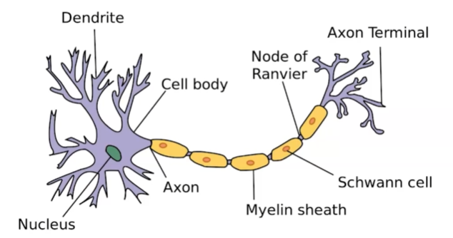
The neurone
Draw a neuron and label its components
What component of the neuron:
Accepts information?
Integrates information?
Transmits information?

Slide 4
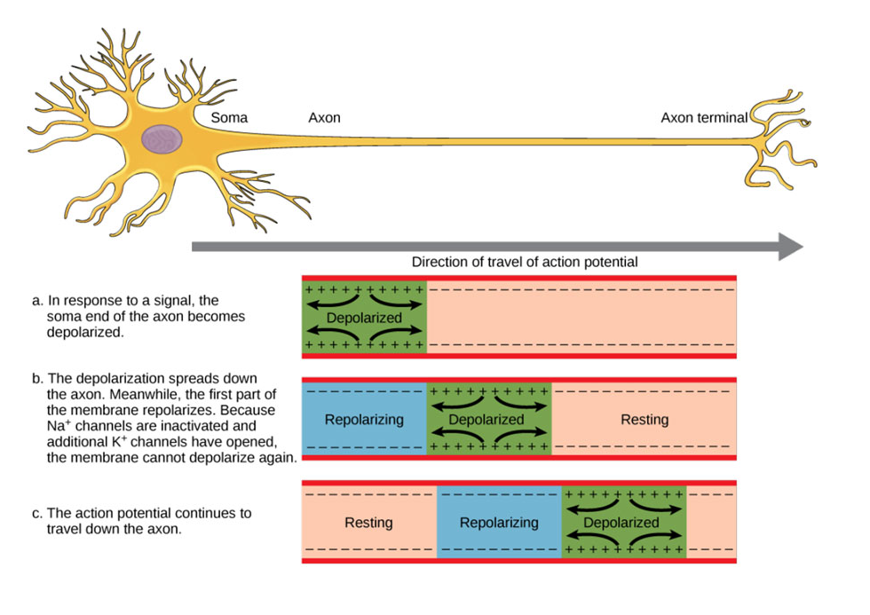
Action potentials
Describe the process in which an action potential travels down a neuron

Slide 5
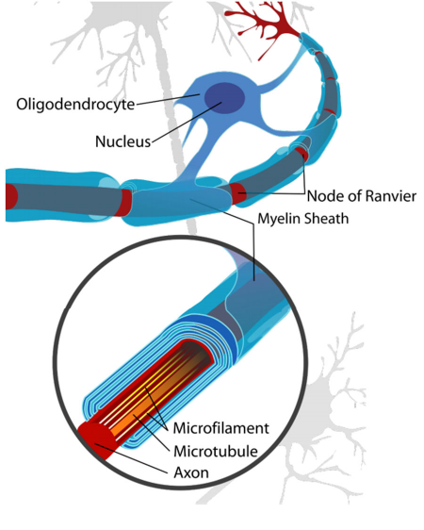
Describe the function of the oligodendrocyte / Schwann cell in nerve conduction
Forms the myelin sheath around neurons, insulates axons and results in nodes of ranviers which allows jumping of action potentials

Slide 6
Synaptic transmission
What final electrolyte/ion is responsible for the release of neurotransmitters into the synaptic cleft?
Ca2+
Neostigmine is a drug which inhibits the acetylcholinesterase (the enzyme which remove acetylcholine from the synaptic cleft). If ACh is responsible for activation of a muscle, what would the addition of neostigmine likely do?
Likely increase free ACh in the neuromuscular junction, resulting in muscle hyperactivity; clinically used in anaesthesia to reverse an NMJ blocking agent (rocuronium)

Slide 7
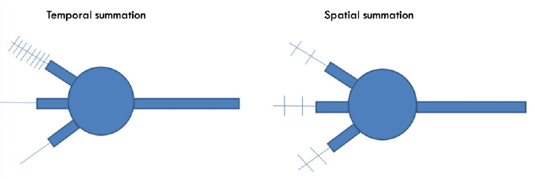
Nerve stimulation
Describe the concept of an EPSP/IPSP in the context of neuronal action potentials

